Slide 1
Capstone Project - The Battle Of Neighborhoods
Finding Better Place in Cheap Price for opening an Indian restaurant

Slide 2
Table of contents
Introduction: Business Problem
Data
Methodology
Result
Discussion
Conclusion

Slide 3
Introduction and Business Problem
Restaurants in Birmingham serve cuisine from every corner of the globe.
Regeneration, renewal and grand-scale construction continue apace in Britain's second-largest city.
Birmingham is Britain’s second-largest city that offers a refreshing break from the busy towns that surround it.
From being a small town to becoming a front runner for its advancements in science, technology, and commerce that gave it names like ‘The City of a 1001 Trades’ and the ‘Workshop of the World.'
With a network of canals and parks, the roots of Birmingham go back to the Middle Ages, but now, it is renowned for its multi-cultural residents and a way of life that beautifully blends the past with the present.
Birmingham is a major city in England’s West Midlands region, with multiple Industrial Revolution-era landmarks that speak to its 18th-century history as a manufacturing powerhouse.

Slide 4
Business Problem
In this project we will try to find an optimal location for an Indian restaurant. Specifically, this report will be targeted to stakeholders interested in opening an Indian Restaurant in Birmingham, England, United Kingdom.
Since there are lots of restaurants in Birmingham, we will try to detect locations that are not already crowded with restaurants. We are also particularly interested in areas with no Indian restaurants in vicinity. We would also prefer locations as close to city center as possible.
We will use our data science powers to generate a few most promising neighborhoods based on these criteria. Advantages of each area will then be clearly expressed so that best possible final location can be chosen by stakeholders.

Slide 5
Data
Data 1:
Neighborhood has a total of 16 Boroughs and 73 Neighborhoods. In order to segment the neighborhoods and explore them , we will essentially need a dataset that contains the 16 boroughs and the neighborhoods that exist in each borough as well as the latitude and longitude coordinates of each neighborhood. This dataset exists for free on the web. Link to the dataset is : https://en.wikipedia.org/wiki/B_postcode_area

Slide 6
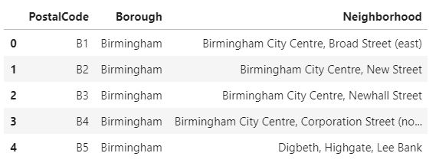
DataFrame

Slide 7
Data
Data 2:
Birmingham City geographical coordinates data will be utilized as input for the Foursquare API, that will be leveraged to provision venues information for each neighborhood. We will use the Foursquare API to explore neighborhoods in Birmingham city.
Indian Restaurant category ID 4bf58dd8d48988d10f941735 is used for retrieving data from Foursquare API.
The coordinates are: https://github.com/tanaya86/Coursera_Capstone/blob/main/postcode-outcodes.csv

Slide 8
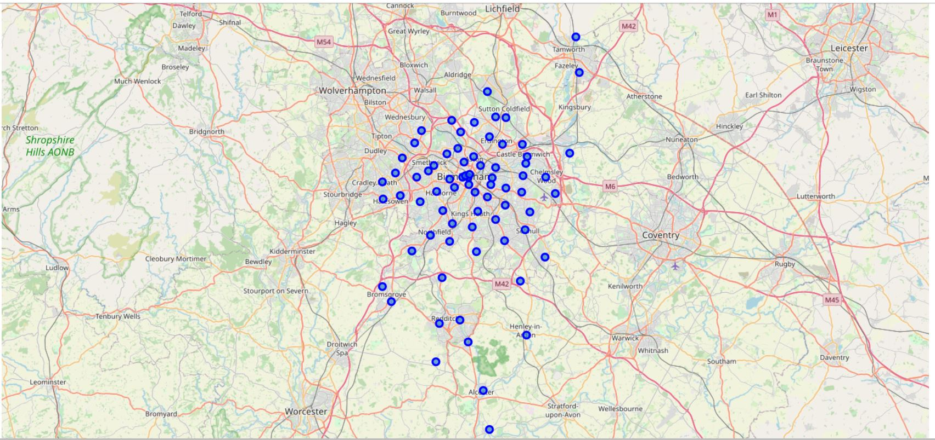
Map of Birmingham

Slide 9
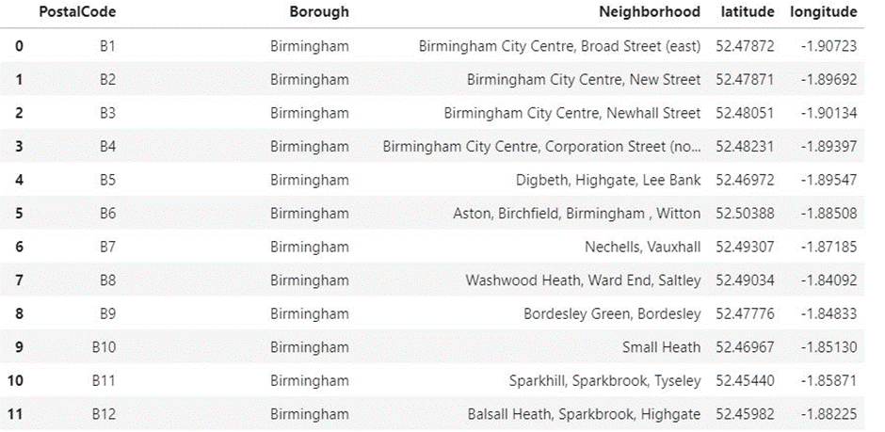
Methodology
In this project, I will use the basic methodology.

Slide 10
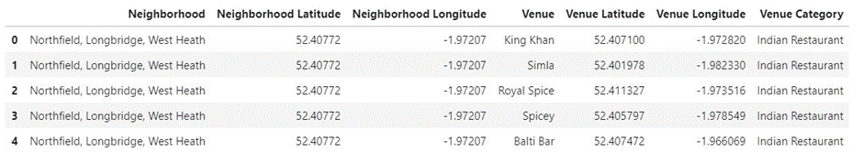
Methodology
After That, we will explore function to get Indian Restaurant categories in each neighborhood.

Slide 11
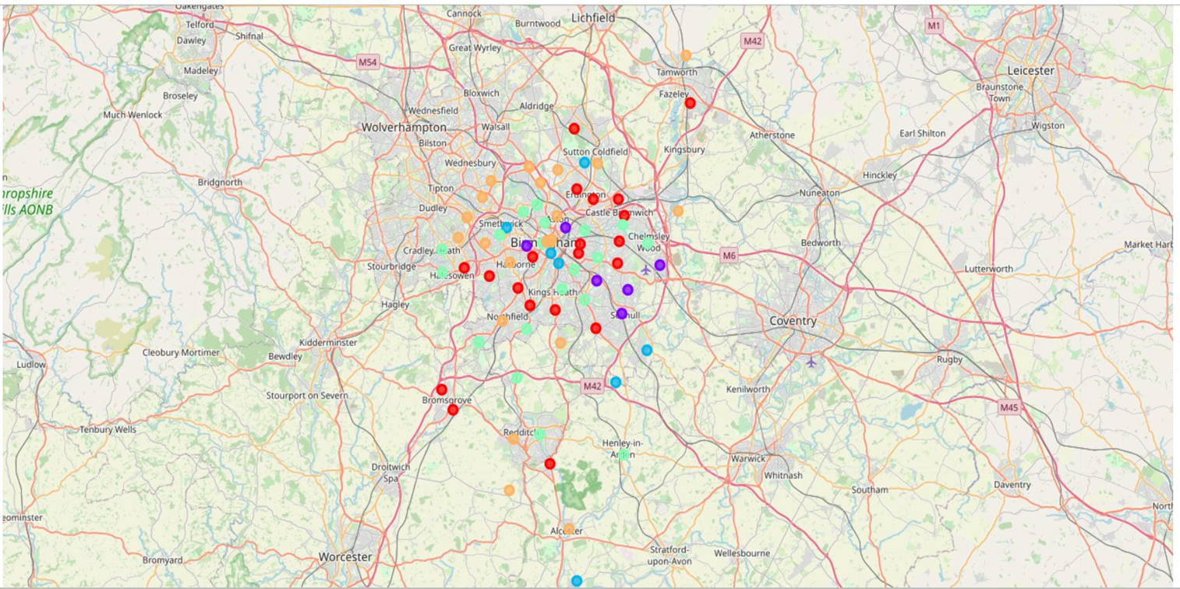
Methodology
Then to group the neighborhoods into clusters K-means clustering algorithm will be used. And to visualize the neighborhoods in Birmingham and its emerging clusters.

Slide 12
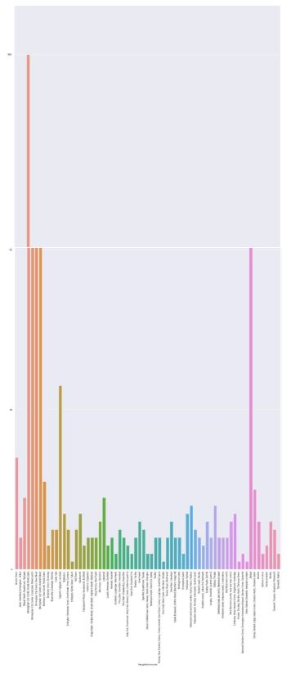
Result
Bar Plot of number of venues per neighborhood

Slide 13
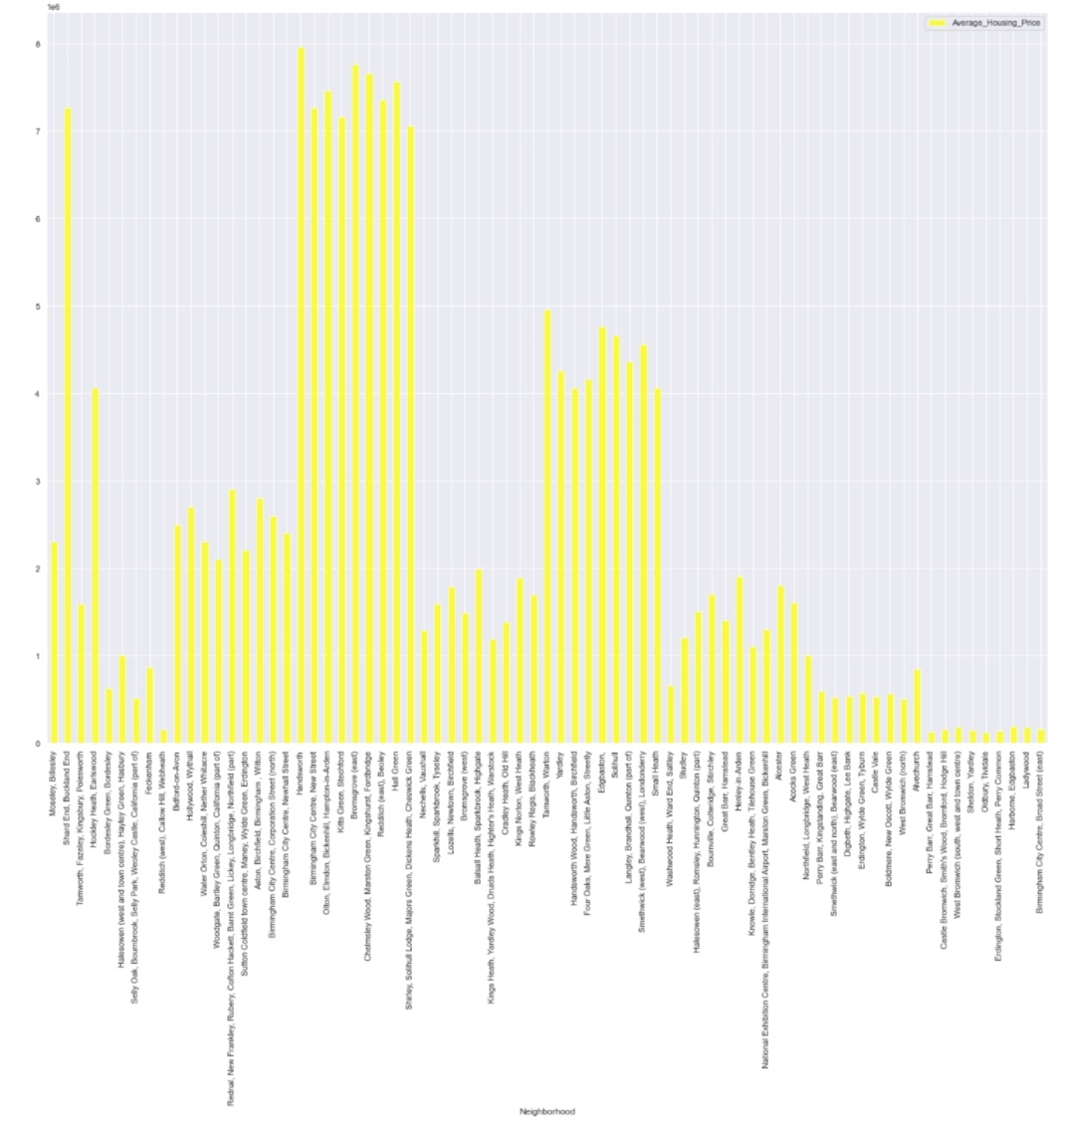
Result
Average Housing Prices In Birmingham to look the cheapest price for Buying a place for a restaurant
Based on data frame of Indian restaurants, except the places in a data frame we can decide about the remaining places to open a new Indian restaurant.

Slide 14
Discussion
The major purpose of this project, is to suggest a better neighborhood in a new city for the person who wants to open a new Indian restaurant. Social presence in society in terms of likeminded people. Connectivity to the airport, bus stand, city center, markets and other daily needs things nearby.
Sorted list of houses in terms of housing prices in a ascending or descending order
Sorted list of places having Indian Restaurant

Slide 15
Conclusion
Purpose of this project was to identify Birmingham areas with low number of Indian restaurants in order to aid stakeholders in narrowing down the search for optimal location for an Indian restaurant. Clustering of those locations was then performed in order to create major zones of interest (containing greatest number of potential locations) and addresses of those zone centers were created to be used as starting points for final exploration by stakeholders.
Final decision on optimal Indian restaurant location will be made by stakeholders based on specific characteristics of neighborhoods and locations in every recommended zone, taking into consideration additional factors like attractiveness of each location (proximity to park or water), levels of noise / proximity to major roads, real estate availability, prices, social and economic dynamics of every neighborhood etc.

